Slide 1

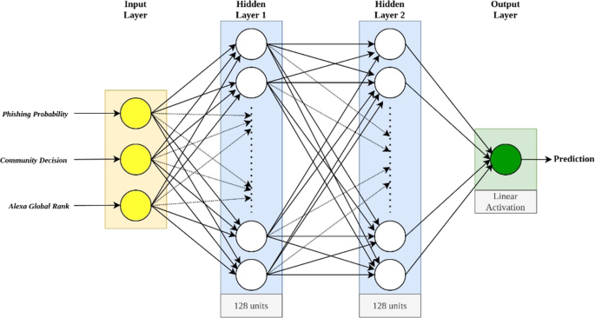
Detection of Online Phishing Emails Using Dynamic Evolving Neural Network Based on Reinforcement Learning
Module: Intelligent Decision Support System
Made By: Krishna Gopal Sharma
University No: S3454618

Slide 2

Introduction
Phishing is a common and persistent type of cyber-attack that aims to trick people into sharing personal information by posing as legitimate messages.
Traditional detection methods, like blacklists or basic machine learning, often struggle with 'zero-day' phishing attacks.
Author: Sami Smadi, Nauman Aslam, and Li Zhang, presents a fresh approach using reinforcement learning and neural networks to identify phishing emails in real-time.

Slide 3
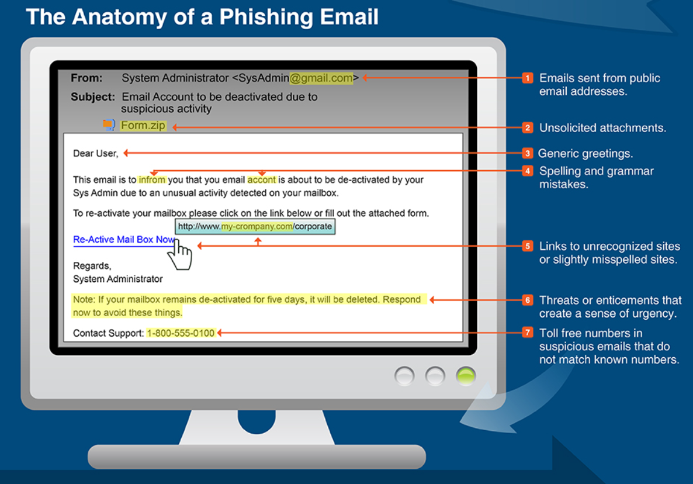
Related Work
Traditional phishing detection methods include blacklists and machine learning approaches.
However, these methods are limited by their reliance on known data or fixed datasets, which makes them ineffective for novel attacks.
Multi-algorithm models have improved accuracy, but they still struggle with 'zero-day' attacks.
This study improves on these methods by integrating reinforcement learning, which allows for automatic adaptation to new phishing tactics.

Slide 4
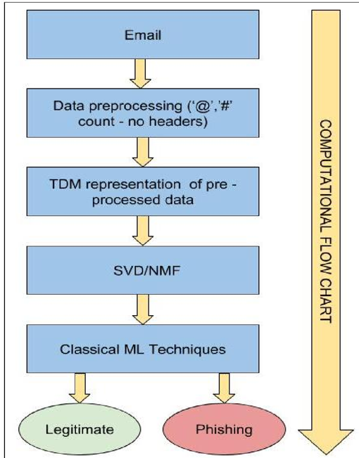
Phishing Email Detection System (PEDS)
The proposed system combines reinforcement learning with neural networking to create an adaptable phishing detection model.
Key components include feature evaluation (FEaR) and a dynamic evolving neural network (DENNuRL) that adapts in real-time.

Slide 5
1. Feature Evaluation and Reduction (FEaR) Algorithm
The FEaR algorithm analyzes different parts of an email (sender, URLs, message content) to identify key features indicative of phishing.
By focusing on the most relevant features, it speeds up detection and reduces the system's computational load.
The algorithm uses feature ranking to prioritize the most significant signals, improving efficiency without sacrificing detection accuracy.

Slide 6

2. Dynamic Evolving Neural Network Using Reinforcement Learning (DENNuRL)
Reinforcement learning allows the model to refine its detection capabilities by rewarding correct classifications and penalizing errors.
This leads to continuous improvement in accuracy and adaptability.
DENNuRL adapts over time, learning from each phishing email it encounters.
DENNuRL’s ability to evolve dynamically allows it to keep up with emerging phishing techniques without requiring manual updates.

Slide 7
Testing the Model
Testing on known phishing datasets yielded a detection accuracy of 98.63%.
The system also effectively identified new, previously unseen phishing tactics, showcasing its adaptability.
The high accuracy rate suggests that the system is robust and well-suited for real-time phishing email detection.

Slide 8
Future Enhancements
Future improvements could involve incorporating diverse datasets for greater regional and linguistic adaptability.
Natural Language Processing (NLP) could analyze email content more deeply to identify subtle linguistic patterns indicative of phishing.
Hybrid models combining reinforcement learning with deep learning techniques, such as convolutional neural networks (CNNs), could enhance detection further.
Another approach could involve incorporating data from social networks to recognize phishing attempts originating from impersonation.

Slide 9
Alternative Solutions & Expanded Future Vision
Other alternatives may include hybrid detection systems that combine supervised and unsupervised learning for more robust performance.
Federated learning techniques could be explored to create decentralized models that improve data privacy while still enhancing the model’s learning capabilities.
In addition, more research into adversarial attacks on machine learning systems could help build defenses against potential exploitation of the model.
Integrating PEDS with email clients and security software could provide real-time alerts, making it an effective tool for both individuals and organizations.

Slide 10

Conclusion
The study introduces a dynamic phishing detection system that adapts to new phishing tactics in real-time.
By combining the FEaR algorithm and DENNuRL model, the system achieves an accuracy rate of 98.63% with minimal error.
This approach offers a significant advantage over traditional methods and has strong potential for future development.

Slide 11
THANK YOU
Questions or Comments?

